Slide 1
Database Systems

Slide 2
Data
Data refers to the facts & figures concerning:
PEOPLE
EVENT
ORGANISATION
OBJECT
The modern data sources/types include multimedia data, sensor’s data, data on web and so on.
To get most out of data, we require tools than can simplify the task of managing the data and extract useful information out of it in timely fashion.

Slide 3
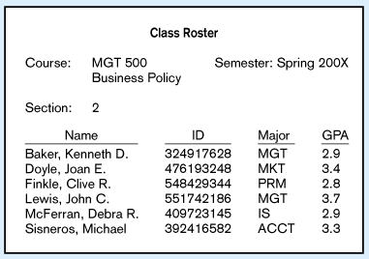
Data
Large volume of facts, difficult to interpret or make decisions based on

Slide 4
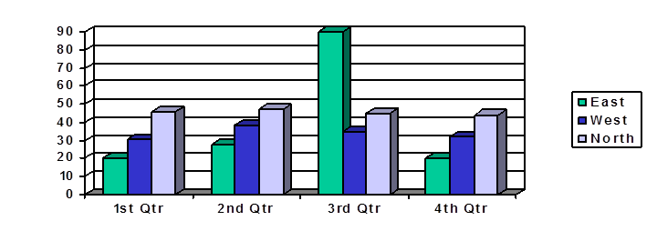
Data vs Information
Information is derived from data OR Information is the processed data
Information may be presented either Textually or Graphically or both
The representation and amount of information depends upon the requirements of a user.
When data is processed and organized into a form needed for its application, it is called an Information Product (IP).

Slide 5
Data vs Information
Accurate, reliable, relevant and timely information is key to good decision making.
Information is now increasingly viewed as an organizational asset (Redman, 2008) which can be used to improve organizational performance and help an organization gain a competitive advantage in the marketplace.

Slide 6
Data Hierarchy
Field (Data Item)
Record
File
Database

Slide 7
Database
Database is a shared collection of logically related data, and a description of this data, designed to meet the information requirements of multiple users in an organization.
Database System can simply be regarded as a computerized record keeping system.
Database System is a system whose overall purpose is to maintain data and make the information available to its users as per their requirements.
The user of the system can perform the operations like:
Defining structure and types of data
Data manipulation (Insert, Delete, Update, Query etc.)
Enforcing security restrictions

Slide 8
Database
Database is an organized collection of data (and metadata) about entities and the relationships among these entities.
Metadata: Data that describes properties or characteristics of other data OR it is “data about data”.
The description of data is also known as system catalog or data dictionary.
Metadata allows database designers & users to understand what data exists and what the data mean?
Metadata describes the domain (set of possible values) for a data item.

Slide 9
Metadata Example
Data Item |  | Value
Name | Type | Length | Min | Max | Description
Course | Alphanumeric | 30 |  |  | Course ID & Name
Section | Integer | 1 | 1 | 9 | Section Number
Semester | Alphanumeric | 10 | 1 | 8 | Semester & Year
Name | Alphanumeric | 30 |  |  | Student name
ID | Integer | 9 |  |  | Student ID
Major | Alphanumeric | 4 |  |  | Student Major
GPA | Decimal | 3 | 0.0 | 4.0 | Student GPA

Slide 10
Examples of Database Applications
Databases are everywhere …
Student / Employee’s Information System
Library System
Hotel / Airline Reservation System
Billing System
Stock / Inventory System
Payroll System

Slide 11
Record Keeping Techniques
Manual Record Keeping.
Computerized Record Keeping
File Processing System.
Database System or Integrated Database Environment. (The paradigm shift)

Slide 12
Case Study
Consider a College System consisting of the following offices:
Admission Office.
Academics Office.
Exam Office.
Each Office is maintaining its own set of files for its day to day operations.
Some of the files used in the system are Student’s File, Faculty File, Course File, Correspondence File etc.

Slide 13
Manual System - Drawbacks
High data volume
Not reliable
Inefficient
Duplication of data
Inconsistency
A lot of data movement is required
The System can’t answer complex queries involving multiple departments.

Slide 14
File Processing System
File-based systems were an early attempt to computerize the manual filing system.
In the traditional file processing system, the existing manual system is automated by focusing on the data processing needs of the individual departments instead of treating the organization as whole.
Each application will have its own set of Private Files designed to meet the needs of a particular department.

Slide 15
File Processing System
File – 1
App – 1
(operations + data descriptions)
File – 2
App – 2
(operations + data descriptions)
File – n
App – n
(operations + data descriptions)

Slide 16
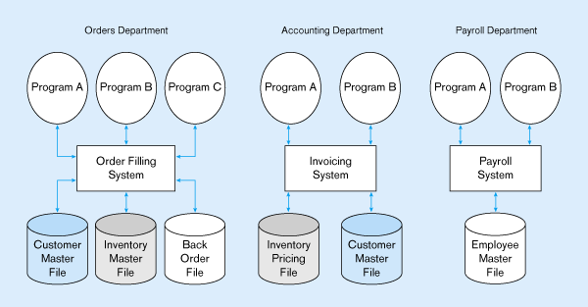
File Processing System
Duplicate Data

Slide 17
Drawbacks of File System
Redundancy of Data
Inconsistent Data
Poor Enforcement of Standards
Excessive Program Maintenance
Limited Data Sharing
Inflexible
Lack of provision for security
Limited recovery from failure

Slide 18
Drawbacks of File System
1. Redundancy of Data
Redundancy means duplication of data.
Since applications in FPS are independent so unplanned duplicate data is there.
Same information is needed to be kept at different places. It costs time and money.
Same data may have to be input several times to update all the occurrences.
Redundancy results in data anomalies (Insert, Update, Delete)

Slide 19
Drawbacks of File System
2. Inconsistent Data.
Redundancy leads to inconsistency.
The same data stored at different places may disagree with each other if an operation has not yet been performed against all the occurrences.
The use of different programming environment and platforms lead to Heterogeneous Environment.
3. Poor Enforcement of Standards
Organization wide enforcement of standards is poor. This leads to the following types of inconsistencies:
Synonym: Using different names for same data item
Example: Stu-Id, Reg-No.
b) Homonym: Using same name for different data items.
Example: “course” for a single subject or entire program.

Slide 20
Drawbacks of File System
4. Excessive Program Maintenance
Physical structure and storage of files are stored in the application code. Against any change in the data, all the application using that data are needed to be changed. Such applications are called Data Dependent Applications.
File descriptions are stored within each application program that accesses a given file (a collection of related records). Any change to a file structure requires changes to the file description for all programs that access the file.
Often difficult to locate all programs affected by change
Errors are often introduced when making changes.
Incompatible file structures.

Slide 21
Drawbacks of File System
5. Limited Data Sharing:
As each application has its own private files so little opportunity to share data with others.
The filing system works well when we have to interact with each file separately. However, it breaks down when we have to cross-reference or process the information in the files. This makes it hard to answer queries involving multiple files.
6. Inflexible
7. Lack of provision for security
8. Limited recovery from failure

Slide 22
Integrated Database Environment(IDE)
The limitations of file-based approach can be attributed to the following factors:
Redundancy of data.
Data dependence: the definition of data is embedded in the application programs, rather than being stored separately and independently.
In contrast to file processing system, the IDE has a single large repository of data.
Emphasizes the integration & sharing of data throughout the organization.
The organization wide requirements are analyzed as a whole and there is no longer concept of MY FILE or Private Files.
A Database Management System (DBMS) is a software designed to assist in maintaining and utilizing large collections of data.
By storing data in a DBMS rather than as a collection of files, we achieve enormous advantages.

Slide 23
Database System
Database
(Data + Data Descriptions)
D
B
M
S
App – 1 (Operations)
App – 2 (Operations)
App – n (Operations)
DBMS manages data resources like an operating system manages hardware resources

Slide 24
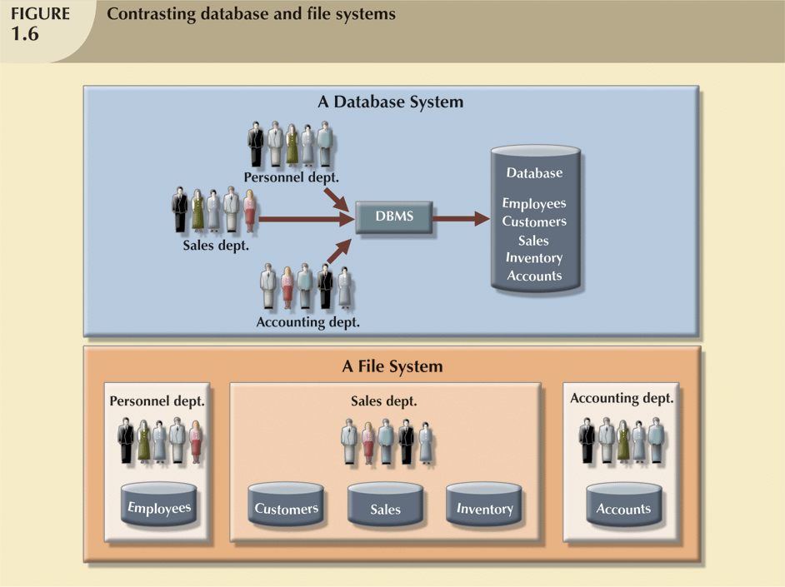

Slide 25
Advantages of Database Approach
Reduced or Controlled Data Redundancy
Improved Data Consistency
Enforcement of Standards
Reduced Program Maintenance
Data Sharing
Data Integrity (Improved Data Quality)
Improved Security Restrictions
Improved Accessibility & Responsiveness
Improved Decision Making
Data Independence

Slide 26
The Range of Database Applications
Single user with desktop computer
Main frame computer with thousands of users
Categories are:
Personal computer databases(Single User)
Workgroup databases(Multi-user )
Department databases (Multi-user )
Enterprise database (Multi-user )
Internet, Intranet & Extranet DBs (Multi-user )

Slide 27
The Range of Database Applications
Personal Computer Databases
Support one user with a standalone PC
E.g. a student’s own database or a sales person’s simple database
Workgroup Databases
Workgroup: relatively small group of people who collaborate on same project/application.
A workgroup DB supports the collaborative efforts of a workgroup.
Allows data sharing.
Its model is shown on the next fig:

Slide 28
Continued…
LAN
DB Server
Workgroup
DB
Workgroup DB on LAN
(Method of Data Sharing)

Slide 29
The Range of Database Applications
Department Databases
Department: Functional unit within an organization
Department DBs support function & activities of a department.
E.g. personnel DB to track employees, jobs, skills etc.
Enterprise Databases
DB scope is the entire organization
To support organization-wide operations & decision making.

Slide 30
Continued…
Hospital
Medical
Clinic
Corporate
Office
Hospital
Nursing
Home
Data Warehouse
Medical
Clinic

